Slide 1

TEAM : The
Shield Crew
PROJECT : Power Consumption Prediction
http://www.free-powerpoint-templates-design.com

Slide 2

Team Crew
L . Srinivas
K . Naveen
V . Aryan Akshay
D . Rakesh
B . Sai Manoj

Slide 3
Contents :
Abstract
Importance
Features
Tools & Technologies
Snapshots

Slide 4
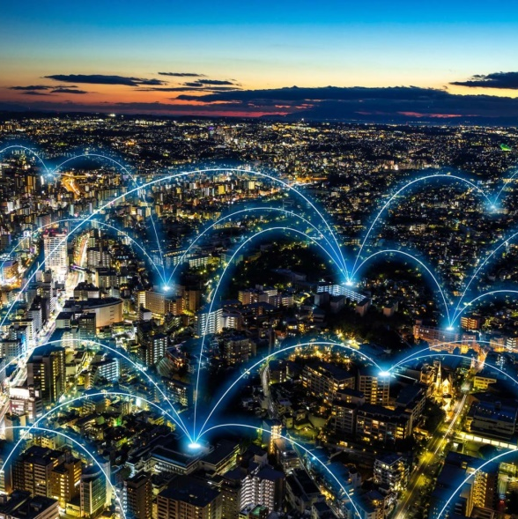
Abstract :
Get a PowerPoint Presentation that is beautifully designed. I hope and I believe that this TempAlate will your Time.
What is Power Consumption..?
The ’Power Consumption’ is all about total power consumed by a particular house hold or total power consumed globally over span of time .
Power consumption can help people to estimate how much power they are utilizing to their households
Power consumption can be calculated using following criteria like : No of hours usage , No of days usage , Capacity of appliances[watts] in Kwh.

Slide 5

Importance :
Intact, our country's installed power generating capacity of 334.4 gigawatt (GW, or 1,000 megawatts) as of January 2019 is the world's fifth-largest
These statistics is the result, of installed capacity, ... production, consumption, import, export and wholesale price of different energies ...
Here power consumption prediction plays a key role in estimating the futuristic circumstances and accurate result to the masses

Slide 6
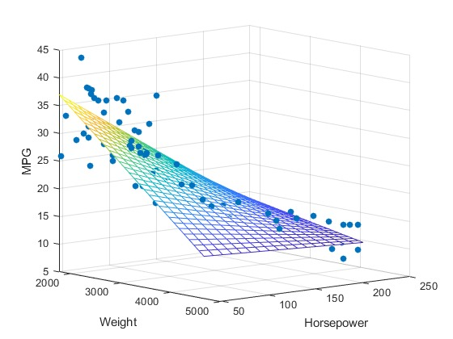
Features
Regression Model
Collinearity:
Our Project is mainly based on the multiple Regression Model . As our dataset has multiple Independent values and one Dependent value . It is an Extension of Simple Linear Regression
Collinearity is a phenomenon in which one feature variable in a multiple regression model can be linearly predicted from the others with a substantial degree of accuracy.
.
01
02
Work Flow
Influence:
electricity consumption model is expected to be influenced by socio-demographic, dwelling characteristics and external factors such as climate and the energy use charges.
.
.
03
Model follows the following workflow:
Gathering data.
Data Wrangling
Analyzing data
Training and testing data
deployment
prediction
04

Slide 7




Tools &
technologies
Python :
It is an general purpose programming language used to facilitate data analysis and visualization in our model.
Jupyter :
It’s an open-source web application that is used to create code and visualizations for our model
IBM Watson :
This impressive artificially intelligent software was developed to advance machine learning capabilities.
Node-js :
A programming tool that deals with set of nodes to drive our model to predict total power consumption

Slide 8
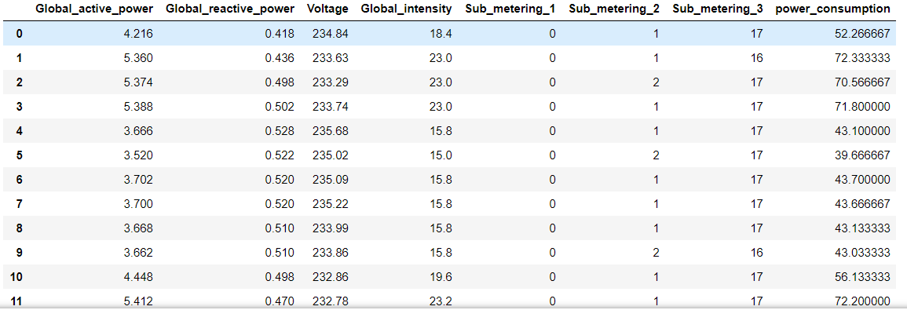
Dataset
“Dataset”.csv is the dataset you are provided with for this challenge. It contains the input Independent attributes criteria like:
Global_Active_power,Global_reactive_power,Voltage,Global_intensity,Sub_meterings_1,Sub_metering_2,Sub_metering_3 .
Additionally,. Finally, the dataset contains the power_consumption column which consists of the total amount of electricity consumed by the sub_meterings at a certain time. So,Now our goal is to build a machine learning model that uses the step and output (debiet/flow) and possible derivative features to predict the total amount of power Consumed .

Slide 9
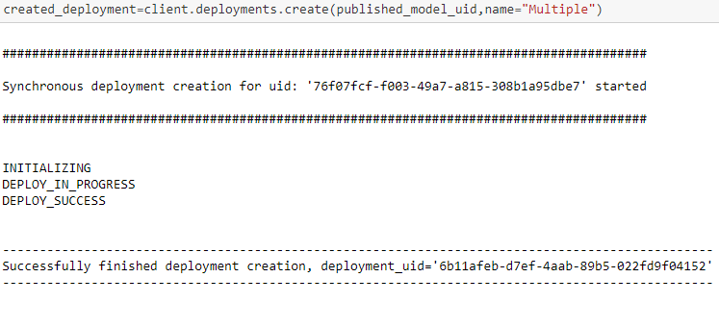
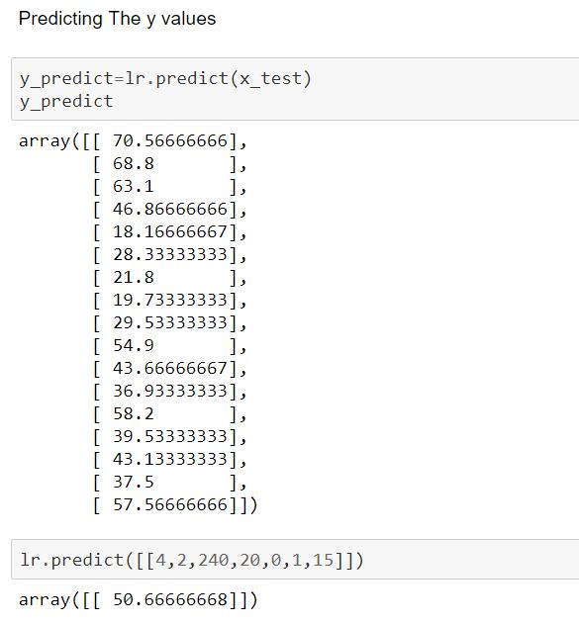
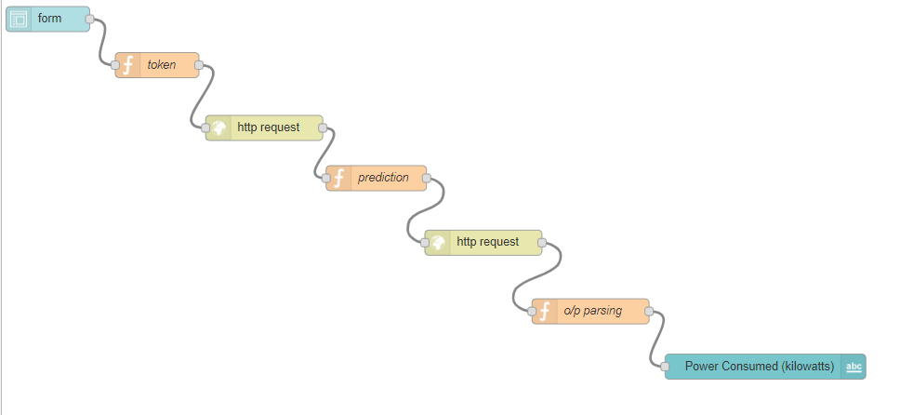
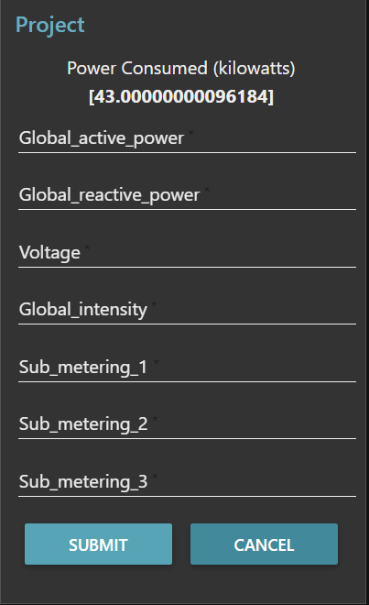
Snapshot's:
Fig 2 : Our model is successfully deployed using watson studio
.
Fig 3 : interlinking of nodes in node-Red editor
Fig 1: Y predicted values in jupyter Notebook
Fig 4 : A user interface form with predicted value

Slide 10
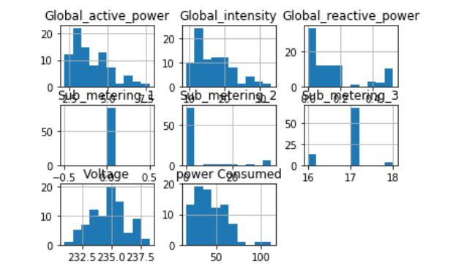
Histogram Representation

Slide 11

Thank You

